Slide 1

2. Modeling with UML

Slide 2
Outline
History of Object Oriented Method
More Object Oriented Concepts
Modeling Concepts
An Overview of UML
UML Diagrams
Case Study

Slide 3
1. History of Object Oriented Method

Slide 4
1.1The Growth of OO Methods
In 1965 the first object-oriented (OO) programming language, Simula I, was introduced.
Almost immediately interest in OO design began to rapidly grow.
This led to the emergence of numerous competing OO design methods.

Slide 5
OO Analysis vs. OO Design
Analysis refers to understanding the problem.
Design refers to coming up with the solution.
Don’t confuse with broader use of word “design”

Slide 6
With all these design methods came numerous modeling languages.
By the early 90’s there were 50+ distinct OO modeling languages.
Darwinian forces in the marketplace led to three dominate methods, each having its own modeling language.
Notes:
Obviously there are too many languages.
They have to compete with each other.

Slide 7
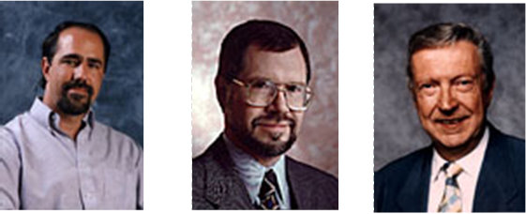
1.2 Three Dominant Methods
Object-oriented Analysis & Design (OOAD) – Grady Booch
The Object Modeling Technique (OMT) – Jim Rumbaugh
The Object-oriented Software Engineering method (OOSE) – Ivar Jacobson
Each one had its strengths and weaknesses.

Slide 8
(1) Booch (OOAD)
Very complex
The modeling language contained a formidable number of diagrams and resulting symbols
Allowed for effective low-level design and its fine grain detail was even useful for documenting code.
Good at OO design, weak at OO analysis

Slide 9
(2) Rumbaugh (OMT)
OMT had a simpler modeling language
It was better at higher-level designs than Booch Method.
Good at OO analysis, weak at OO design

Slide 10
(3) Jacobson (OOSE)
Major feature was “use classes”
Use classes model how a system interacts with users (which might be other systems or end users)
Viewing things from the user’s perspective drove the design process
This made it good at very high-level design.

Slide 11
Coming Together
Booch (OOAD) good at low-level design
Jacobson (OOSE) good at high-level design
Rumbaugh (OMT) good at the middle ground

Slide 12
Booch’s and Rumbaugh’s methods seemed to be evolving in a similar direction
In 1994 they joined forces in effort to merge their two methods
They both wanted to include use cases, so soon Jacobson joined them

Slide 13
It became too difficult to successfully merge all three methods.
At same time, the software engineering community wanted an effective and standardized modeling language
The three then focused their efforts on unifying their three modeling languages

Slide 14

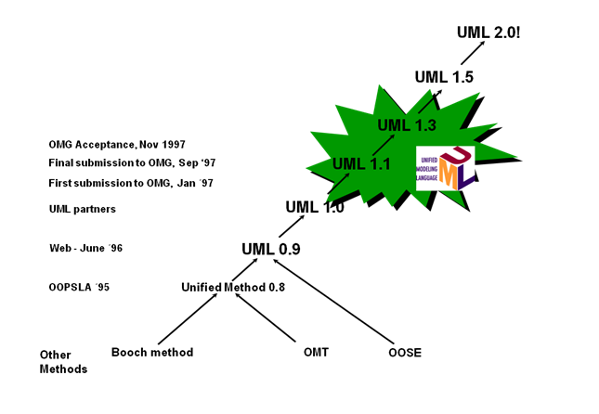
1.3 UML was Born
In 1996 the Unified Modeling Language was introduced as UML 0.9 and then 0.91
Input was obtained from many, including TI, IBM, Microsoft, Oracle, and HP.
This led to UML 1.0 in 1997
Eventually, the semantics and flexibility was improved resulting in UML 2.0 in 2003

Slide 15
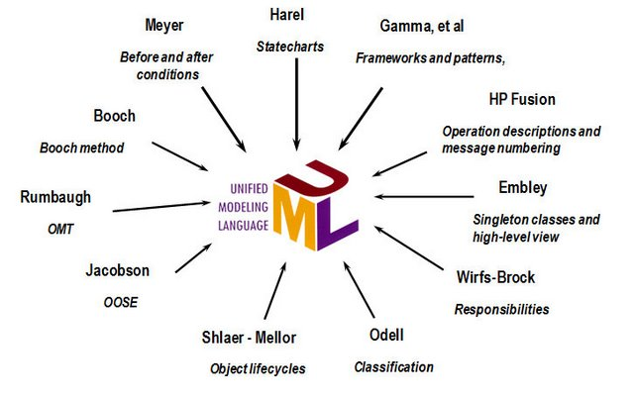
Since its publication in 1991, the UML has been enhanced based on the work of many different authors.

Slide 16
2. Modeling Concept

Slide 17
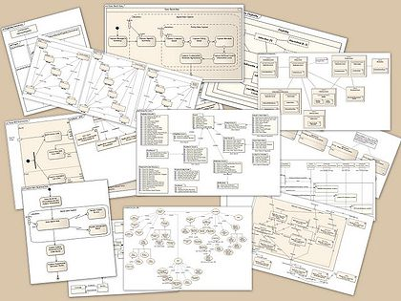
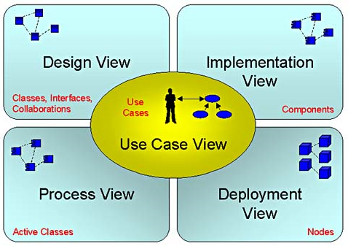
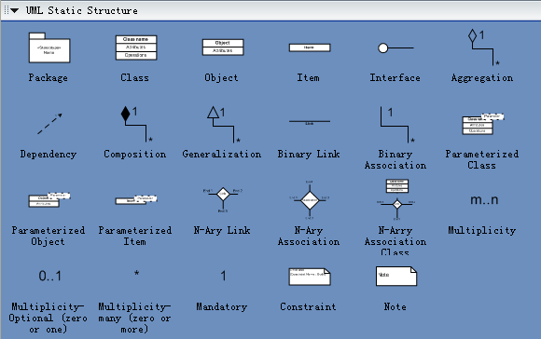
2.1 Systems, Models and Views
A system is an organized set of communicating parts
System is too complex and modeling is a means for dealing with complexity
Unfortunately, a model itself is also very complex. A view is a subset of a model
Notations are graphical or textual rules for representing views

Slide 18
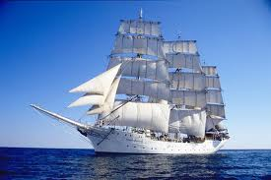

2.2 Different Domains
Application Domain: It represents all aspects of the user’s problem
Solution Domain: is the modeling space of all possible systems
Object Oriented
Application Domain
Solution Domain
Object Oriented
design
Object Oriented
Analysis

Slide 19
3. An Overview of UML

Slide 20

3.1 UML is for Visual Modeling
A picture is worth a thousand words!
Uses standard graphical notations
Semi-formal
Captures Business Process from enterprise information systems to distributed Web-based applications and even to hard real time embedded systems
Sales Representative
Places Order
Customer
Fulfill Order
Item
via
Ships the Item
Business Process

Slide 21
3.2 UML is also for …
Specifying
Building models that are: Precise, Unambiguous, Complete
UML symbols are based on well-defined syntax and semantics.
UML addresses the specification of all important analysis, design, and implementation decisions.
Constructing
Models are related to OO programming languages.
Round-trip engineering requires tool and human intervention to avoid information loss
Forward engineering — direct mapping of a UML model into code.
Reverse engineering — reconstruction of a UML model from an implementation.
Documenting
Architecture, Requirements, Tests, Activities (Project planning, Release management)

Slide 22
3.3 Architecture & View
UML is for visualizing, specifying, constructing, and documenting with emphasis on system architectures (things in the system and relationships among the things) from five different views
Architecture -A set of significant decisions
Design View
Implementation View
vocabulary
functionality
system assembly
configuration mgmt.
Use Case View
behavior
Process View
Deployment View
system topology
distribution
delivery
installation
performance
scalability
throughput
Notes:
Architecture
Organization of a software system.
Selection of structural elements & interfaces from which a system is composed.
Behavior or collaboration of elements.
Composition of structural and behavioral elements.
Architectural style guiding the system.
Use Case View
Use Case Analysis is a technique to capture business process from user’s perspective.
Encompasses the behavior as seen by users, analysts and testers.
Specifies forces that shape the architecture.
Static aspects captured in use case diagrams.
Dynamic aspects captured in interaction diagrams, statechart diagrams, and activity diagrams.
Design View
Encompasses classes, interfaces, and collaborations that define the vocabulary of a system.
Supports functional requirements of the system.
Static aspects captured in class diagrams and object diagrams.
Dynamic aspects captured in interaction, statechart, and activity diagrams.
Process View
Encompasses the threads and processes defining concurrency and synchronization.
Addresses performance, scalability, and throughput.
Static and dynamic aspects captured as in design view; emphasis on active classes.
Implementation View
Encompasses components and files used to assemble and release a physical system.
Addresses configuration management.
Static aspects captured in component diagrams.
Dynamic aspects captured in interaction, statechart, & activity diagrams.
Deployment View
Encompasses the nodes that form the system hardware topology.
Addresses distribution, delivery, and installation.
Static aspects captured in deployment diagrams.
Dynamic aspects captured in interaction, statechart, & activity diagrams.

Slide 23
3.4 Three basic building blocks of UML
Things
important modeling concepts (individual ones as the primitive kinds)
Relationships
tying individual things (i.e., their concepts)
Diagrams
grouping interrelated collections of things and relationships
UML=Things+Relationships+Diagrams

Slide 24
3.4.1 Things
Structural — nouns of UML models.
Behavioral — dynamic (verbal) parts of UML models.
Grouping — organizational parts of UML models.
Annotational — explanatory parts of UML models.
Things=Structural+Behavioral+Grouping+Annotational

Slide 25
(1) Structural Things in UML
Nouns of UML models.
Conceptual or physical elements.
Class
Active Class
Collaboration
Window
origin
size
open( )
close( )
move( )
Event Mgr
thread
time
suspend( )
flush( )
stop( )
Node
Chain of
Responsibility
WebServer
Place
Order
listbox
IWindow
Interface
Use Case
Component
Notes:
Active Class: Special class whose objects own one or more processes or threads. A rectangle with heavy border
Interface: A collection of operations that specify a service (for a resource or an action) of a class or component. It describes the externally visible behavior of that element.
Collaboration: Define an interaction among a web of objects. Define a society of roles and other elements. Provide cooperative behavior. Capture structural and behavioral dimensions
Use Case: A sequence of actions that produce an observable result for a specific actor. Provides a structure for behavioral things. Realized through a collaboration (usually realized by a set of actors and the system to be built).
Component: Replaceable part of a system. Components can be packaged logically. Conforms to a set of interfaces. Provides the realization of an interface.
Node: Element that exists at run time. Represents a computational resource. Generally has memory and processing power.

Slide 26
(2) Behavioral Things in UML
Verbs of UML models.
Dynamic parts of UML models: “behavior over time and space”
Usually connected to structural things in UML.
Two primary kinds of behavioral things:
Interaction
behavior of a set of objects comprising of a set of message exchanges within a particular context to accomplish a specific purpose.
display
State Machine
behavior that specifies the sequences of states an object or an interaction goes through during its lifetime in response to events, together with its responses to those events.
Idle
Waiting

Slide 27
(3) Grouping Things in UML
Packages - one primary kind of grouping.
- General purpose mechanism for organizing elements into groups.
- Purely conceptual; only exists at development time.
- Contains behavioral and structural things.
- Can be nested.
- Variations of packages are: Frameworks, models, & subsystems.
Meeting Scheduler
Notes:
When we model a complicated system, too many elements will be defined. It is difficult to manage these elements. We can group them as a package.

Slide 28
(4) Annotational Things in UML
Explanatory parts of UML models
Comments regarding other UML elements (usually called adornments in UML)
Note is one primary annotational thing in UML
best expressed in informal or formal text.
flexible
drop-out dates

Slide 29
3.4.2 Relationships
Dependency
Association
Generalization
Realization
Notes:
Modeling elements are connected with each other through different relationships.
Relationship discovering and defining is the most difficulty task in modeling.

Slide 30
Dependency
a semantic relationship between two things in which a change to one thing (independent) may affect the semantics of the other thing (dependent).
Directed is optional and label is optional.

Slide 31
Associations
a structural relationship that describes a set of links, a link being a connection between objects.
Can be directed labels Can have multiplicity & role names
employer
employee
0..1
*
Aggregation
a special kind of association. It represents a structural relationship between the whole and its parts.
Represented by a black diamond.

Slide 32
Generalization
a specialization/generalization relationship in which objects of the specialized element (the child) are more specific than the objects of the generalized element.

Slide 33
Realization
a semantic relationship between two elements, wherein one element guarantees to carry out what is expected by the other element.
Where?
Between interfaces and classes that realize them…
Between use cases and the collaborations that realize them...

Slide 34
3.4.3 Diagrams
Graphical representation of a set of elements.
Represented by a connected graph: Vertices are things; Arcs are behaviors.
5 most common views built from 9 diagram types.
Class Diagram; Object Diagram
Use case Diagram
Sequence Diagram; Collaboration Diagram
Statechart Diagram
Activity Diagram
Component Diagram
Deployment Diagram

Slide 35
Diagrams and System Model:
Functional model: Use case diagram
Object model: Class diagram
Dynamic model: Sequence diagrams, statechart, activity diagrams
Notes:
Powerful, but complex language
Can be misused to generate unreadable models
Can be misunderstood when using too many exotic features

Slide 36
4. UML Diagrams

Slide 37
Diagrams covered in this talk
Use case diagrams
Describe the functional behavior of the system as seen by the user
Class diagrams
Describe the static structure of the system: Objects, attributes, associations
Interaction diagrams
Describe the dynamic behavior between objects of the system
Statechart diagrams
Describe the dynamic behavior of an individual object
Activity diagrams
Describe the dynamic behavior of a system, in particular the workflow.
Package Diagrams
Describe the groupings of elements
Notes:
Statechart diagrams
Describe the dynamic behavior of an individual object (essentially a finite state automaton)
Activity Diagrams
Model the dynamic behavior of a system, in particular the workflow (essentially a flowchart)

Slide 38
4.1 Use Case Diagrams
Used during requirements elicitation and analysis to represent external behavior (“visible from the outside of the system”)
An Actor represents a role, that is, a type of user of the system
Passenger
A use case represents a class of functionality provided by the system
Use case model:
The set of all use cases that completely describe the functionality of the system.
PurchaseTicket

Slide 39
4.1.1 Actors
An actor is a model for an external entity which interacts (communicates) with the system:
User
External system (Another system)
Physical environment (e.g. Weather)
An actor has a unique name and an optional description
Examples:
Passenger: A person in the train
GPS satellite: An external system that provides the system with GPS coordinates.
Passenger
Optional
Description
Name

Slide 40
4.1.2 Use Case
• A use case represents a class of functionality provided by the system
• Use cases can be described textually, with a focus on the event flow between actor and system
• The textual use case description consists of 6 parts:
Unique name
Participating actors
Entry conditions
Exit conditions
Flow of events
Special requirements.
PurchaseTicket

Slide 41
4.1.3 Communication Relationships
Actors and use cases communicate when information is exchanged between them

Slide 42
4.1.4 Use Case Description
Brief use case -- consists of a few sentences summarizing the use case
Casual use case -- consists of a few paragraphs of text, summarizing the use case.
Fully dressed use case -- a formal document based on a detailed template with fields for various sections; and it is the most common understanding of the meaning of a use case.

Slide 43
Textual Use Case Description Example
Passenger
PurchaseTicket
1. Name: Purchase ticket
2. Participating actor: Passenger
3. Entry condition:
Passenger stands in front of ticket distributor
Passenger has sufficient money to purchase ticket
4. Exit condition:
Passenger has ticket
5. Flow of events:
1. Passenger selects the number of zones to be traveled
2. Ticket Distributor displays the amount due
3. Passenger inserts money, at least the amount due
4. Ticket Distributor returns change
5. Ticket Distributor issues ticket
6. Special requirements: None.
Notes:
Question: Anything missing? Answer: Exceptional cases!
Use cases represent functionality of the system
All use cases need to be described for the model to be useful
Use case diagrams are useful as an index into the use cases
The Textual Use case descriptions provide meat of model, not the use case diagrams.

Slide 44
4.1.5 Use Cases can be related
Extends Relationship
To represent seldom invoked use cases or exceptional functionality
Includes Relationship
To represent functional behavior common to more than one use case.
Inheritance Relationship
One use case can specialize another more general one by adding more detail

Slide 45
The <<extends>> Relationship
<<extends>> relationships model exceptional or seldom invoked cases
The exceptional event flows are factored out of the main event flow for clarity
The direction of an <<extends>> relationship is to the extended use case
Use cases representing exceptional flows can extend more than one use case.
Passenger
PurchaseTicket
<<extends>>
<<extends>>
<<extends>>
OutOfOrder
<<extends>>
TimeOut
Cancel
NoChange

Slide 46
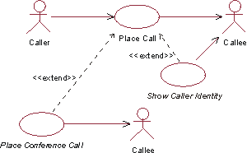

Slide 47
The <<includes>> Relationship
<<includes>> relationship represents common functionality needed in more than one use case
<<includes>> behavior is factored out for reuse, not because it is an exception
The direction of a <<includes>> relationship is to the using use case (unlike the direction of the <<extends>> relationship).
Passenger
PurchaseMultiCard
PurchaseSingleTicket
<<includes>>
<<includes>>
<<extends>>
CollectMoney
<<extends>>
<<extends>>
NoChange
Cancel
Cancel

Slide 48
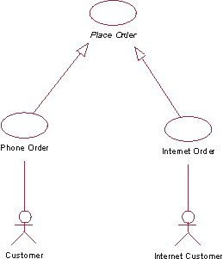
The Inheritance relationships
Different abstraction levels
Authenticate
WithPassword
Authenticate
Authenticate
WithCard

Slide 49
4.1.6 Scenarios
A use case describes all possible scenarios involving the described functionalities
A scenario is an instance of a use case describing a concrete set of actions.
Name
Participating actor instances
Flow of events

Slide 50
4.2 Class Diagrams
Class diagrams represent the structure of the system
Used
during requirements analysis to model application domain concepts
during system design to model subsystems
during object design to specify the detailed behavior and attributes of classes.
TarifSchedule
Trip
Table zone2price
Enumeration getZones()
Price getPrice(Zone)
zone:Zone
Price: Price
*
*

Slide 51
Classes
Type
TarifSchedule
Table zone2price
Enumeration getZones()
Price getPrice(Zone)
Name
TarifSchedule
Attributes
Signature
zone2price
getZones()
getPrice()
Operations
TarifSchedule
A class represents a concept
A class encapsulates state (attributes) and behavior (operations)
Each attribute has a type
Each operation has a signature
The class name is the only mandatory information

Slide 52
Instances
tarif2006:TarifSchedule
:TarifSchedule
zone2price = {
{‘1’, 0.20}, {‘2’, 0.40},
{‘3’, 0.60}}
zone2price = {
{‘1’, 0.20}, {‘2’, 0.40},
{‘3’, 0.60}}
An instance represents a phenomenon
The attributes are represented with their values
The name of an instance is underlined
The name can contain only the class name of the instance (anonymous instance)

Slide 53
Actor vs Class vs Object
Actor
An entity outside the system to be modeled, interacting with the system (“Passenger”)
Class
An abstraction modeling an entity in the application or solution domain
The class is part of the system model (“User”, “Ticket distributor”, “Server”)
Object
A specific instance of a class (“Joe, the passenger who is purchasing a ticket from the ticket distributor”).
Notes:
What is the difference between an actor, a class and an instance?

Slide 54
4.2.2 Associations
TarifSchedule
TripLeg
Enumeration getZones()
Price getPrice(Zone)
*
Price Zone
*
Associations denote relationships between classes
The multiplicity of an association end denotes how many objects the instance of a class can legitimately reference.

Slide 55
(1)The Direction of Association
Association can be directional or bidirectional
Given an order, we can find a specific customer while the order can not be indicated by a customer
Order
*
1
Customer

Slide 56
(2) Multiplicity
Country
1
1
City
name:String
name:String
1-to-1 association
Point
Polygon
*
x: Integer
draw()
y: Integer
1-to-many association

Slide 57
Many-to-Many Associations
Company
*
*
StockExchange
tickerSymbol
Notes:
A stock exchange lists many companies each of them uniquely identified by a ticker symbol used at that stock exchange.
A company can be listed on more than one stock exchange, using the same ticker symbol.
Mercedes Benz is an example for a company listed on more than one stock exchange: Frankfurt and NYSE.
Does it have two different Ticker symbols?
Something not clear here: What happens if the company cannot have the same ticker symbol on two different stock exchanges?

Slide 58
(3) Association Classes
Example
Authorization services assign a merchant ID to each store for identification during communications
A payment authorization request from the store to an authorization service needs the merchant ID that identifies the store to the service
Furthermore, a store has a different merchant ID for each service
Store
both placements of
AuthorizationService
address
merchantID are incorrect
address
merchantID
because there may be more
merchantID
name
than one merchantID
name
phoneNumber

Slide 60
Guidelines
An attribute is related to an association
Instances of the association class have a life-time dependency on the association
There is a many-to-many association between two concepts, and information associated with the association itself

Slide 61
(4) Qualifiers
Without qualification
1
*
File
Directory
filename
With qualification
1
0..1
Directory
filename
File
Qualifiers can be used to reduce the multiplicity of an association
Notes:
In this case, filename is a qualifier attached to Directory
qualifier
US: [ˈkwɑləˌfaɪər] UK: [ˈkwɒlɪˌfaɪə(r)]

Slide 62
Qualification: Another Example
Company
*
Lists
*
StockExchange
tickerSymbol
*
Lists
1
*
Company
StockExchange
tickerSymbol

Slide 63
(5) Aggregation
An aggregation is a special case of association denoting a “consists-of” hierarchy
The aggregate is the parent class, the components are the children classes
Exhaust system
1
0..2
Muffler
Tailpipe
diameter
diameter
A solid diamond denotes composition: A strong form of aggregation where the life time of the component instances is controlled by the aggregate. That is, the parts don’t exist on their own (“the whole controls/destroys the parts”)
TicketMachine
3
ZoneButton
Notes:
Example for composition: Bill of Material

Slide 64
(6) From Problem Statement To Associations
Problem Statement: A stock exchange lists many companies. Each company is uniquely identified by a ticker symbol
Class Diagram:
StockExchange
*
*
Company
Lists
tickerSymbol

Slide 65
From Problem Statement to Code
Pr
oblem Statement
:
A
stock exchange lists many companies.
Each company is identified by a ticker symbol
Class Diagram:
*
*
Company
StockExchange
Lists
tickerSymbol
Java Code
public class StockExchange
{
private Vector m_Company = new Vector();
Associations
are mapped to
Attributes!
};
public class Company
{
public int m_tickerSymbol;
private Vector m_StockExchange = new Vector();
};

Slide 66
4.2.3 Inheritance
Button
CancelButton
ZoneButton
Inheritance is another special case of an association denoting a “kind-of” hierarchy
Inheritance simplifies the analysis model by introducing a taxonomy
The children classes inherit the attributes and operations of the parent class.
Notes:
Later we will also see how inheritance allows the reuse of solutions (implementation and specification inheritance)
taxonomy
US: [tækˈsɑnəmi] UK: [tækˈsɒnəmi]

Slide 67
4.2.4 Packages
Packages help you to organize UML models to increase their readability
We can use the UML package mechanism to organize classes into subsystems
Any complex system can be decomposed into subsystems, where each subsystem is modeled as a package.
Account
Bank
Customer
Notes:
Packages are the grouping construct with

Slide 68
4.2.5 Class Modeling in Practice
Foo
Amount
CustomerId
Deposit()
Withdraw()
GetBalance()
Class Identification: Name of Class, Attributes and Methods
Is Foo the right name?

Slide 69
Naming the class
“Dada”
Foo
Amount
Amount
CustomerId
CustomerId
Deposit()
Deposit()
Withdraw()
Withdraw()
GetBalance()
GetBalance()
Account
Amount
CustomerId
Deposit()
Is Foo the right name?
Withdraw()
GetBalance()
Notes:
Naming is important!

Slide 70
Finding More classes
Account
Amount
Customer
Bank
AccountId
CustomerId
Name
Name
Deposit()
CustomerId
Withdraw()
GetBalance()
1) Find New Classes
2) Review Names, Attributes and Methods

Slide 71
Finding Associations
Account
?
*
Amount
*
Customer
Bank
AccountId
has
?
CustomerId
AccountId
Name
Deposit()
?
Name
CustomerId
Withdraw()
GetBalance()
1) Find New Classes
2) Review Names, Attributes and Methods
3) Find Associations between Classes
4) Label the generic associations
5) Determine the multiplicity of the associations
6) Review associations

Slide 72
Find Taxonomies
Account
Bank
Customer
*
Amount
*
Name
Has
Name
AccountId
CustomerId
AccountId
Deposit()
Withdraw()
GetBalance()
CustomerId()
Savings
Account
Checking
Account
Mortgage
Account
Withdraw()
Withdraw()
Withdraw()

Slide 73
Simplify, Organize
Account
Amount
Show Taxonomies
separately
AccountId
CustomerId
AccountId
Deposit()
Withdraw()
GetBalance()
Savings
Account
Checking
Account
Mortgage
Account
Withdraw()
Withdraw()
Withdraw()

Slide 74
Account
Bank
Customer
*
Amount
*
Name
Has
Name
AccountId
CustomerId
AccountId
Deposit()
Withdraw()
GetBalance()
CustomerId()
Use the 7+-2 heuristics
or better 5+-2!

Slide 75
4.3 Interaction Diagram
Sequence diagram
Emphasizes time ordering of messages.
Depicts the lifeline of objects.
Sequence diagram illustrates interactions in a kind of fence(栅栏) format
Collaboration diagram
Emphasizes structural organization.
Potentially easier to model complex interactions.
Collaboration Diagram illustrates object interactions in a graph or network format
message
sequence number
1.1 : getLastCheckpoint( )
1 : getPositionAtTime( t )
t : AirTrafficPlanner
p : FlightPlan
link
object
Notes:
Patterns of communication among a set of interacting objects.
An object interacts with another object by sending messages

Slide 76
4.3.1 Sequence Diagrams
Focus on
Controlflow
Used during analysis
To refine use case descriptions
to find additional objects (“participating objects”)
Used during system design
to refine subsystem interfaces
Instances are represented by rectangles. Actors by sticky figures
Lifelines are represented by dashed lines
Messages are represented by arrows
Activations are represented by narrow rectangles.
Passenger
TicketMachine
selectZone()
Messages ->
Operations on
participating Object
insertCoins()
pickupChange()
TicketMachine
zone2price
selectZone()
insertCoins()
pickupChange()
pickUpTicket()
pickUpTicket()

Slide 77
Sequence Diagrams can also model the Flow of Data
Passenger
ZoneButton
TarifSchedule
Display
selectZone()
lookupPrice(selection)
price
Dataflow
displayPrice(price)
…continued on next slide...
The source of an arrow indicates the activation which sent the message
Horizontal dashed arrows indicate data flow, for example return results from a message

Slide 78
Sequence Diagrams: Iteration & Condition
…continued from previous slide...
Passenger
ChangeProcessor
CoinIdentifier
Display
CoinDrop
*
insertChange(coin)
lookupCoin(coin)
Iteration
price
displayPrice(owedAmount)
Condition
[owedAmount<0] returnChange(-owedAmount)
…continued on next slide...
Iteration is denoted by a * preceding the message name
Condition is denoted by boolean expression in [ ] before the message name
Notes:
square brackets ([ ])

Slide 79
Creation and destruction
…continued from previous slide...
ChangeProcessor
Creation of Ticket
Passenger
createTicket(selection)
Ticket
print()
free()
Destruction of Ticket
Creation is denoted by a message arrow pointing to the object
Destruction is denoted by an X mark at the end of the destruction activation
In garbage collection environments, destruction can be used to denote the end of the useful life of an object.
Notes:
Cross

Slide 80
4.3.2 Collaboration Diagram
: Order
Object
Fulfillment
5: acknowledgeOrder
: Order Clerk
4: triggerBill
3: placeOrder
1: submitOrder
: Billing
Agent
Link
Link is a semantic connection
among objects… an instance
of an association
2: processCard
: Order
: CreditCard
Taker
Agen
Message
Message is a specification of a communication between objects
that conveys information with the expectation that activity will occur.

Slide 81
Illustrating Links
A Link is a connection between two instances

Slide 82
Illustrating Messages
Messages between objects are represented via a labeled arrow on a link line
msg1()
1: msg2()
2: msg3()
3: msg4()
: Register
:Sale
3.1: msg5()
all messages flow on the same link

Slide 83
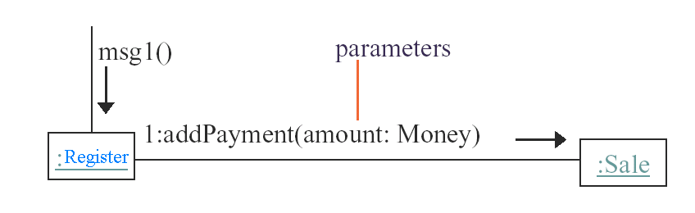
Illustrating Parameters
Parameters of a message may be shown within parentheses following the message name

Slide 84
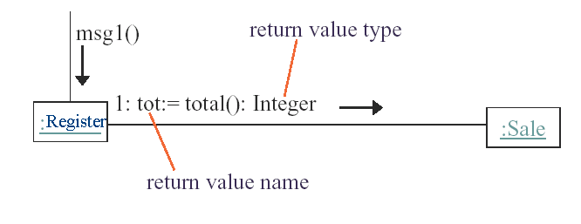
Illustrating a Return Value
A return value variable name and an assignment operator := preceding the message

Slide 85
illustrating Messages to “self” or “this”

Slide 86
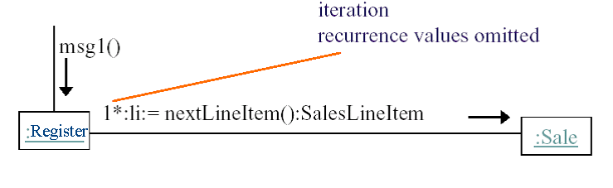
Illustrating Iteration
Following the sequence number with a star (*)

Slide 87
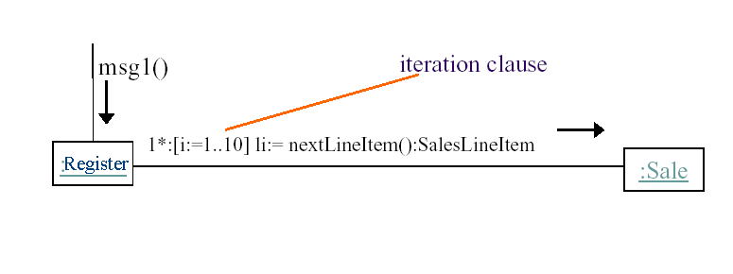
Illustrating Iteration Clause

Slide 88
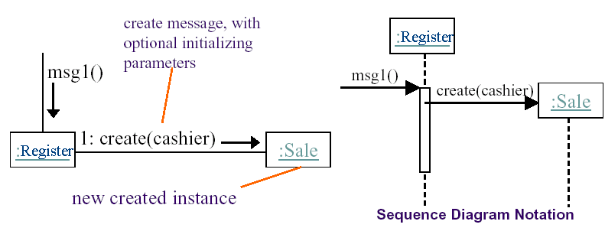
Illustrating Creation of Instances
create message sent to the instance being created

Slide 89
Illustrating Message Number Sequencing
The first message is not numbered
The order and nesting of subsequent messages is shown with a legal numbering scheme in which nested messages have appended to them a number.
Nesting is denoted by prepending the incoming message
number to the outgoing message number.

Slide 90
first
second
third
msg1()
;ClassA
1: msg2()
:ClassB
1.1: msg3()
2.1: msg5()
2: msg4()
:ClassC
fourth
fifth
2.2: msg6()
sixth
:ClassD

Slide 91
Mutually Exclusive Conditional Paths
unconditional after
either msg2 or msg4
:ClassE
1a and 1b are mutually
exclusive conditional paths
2: msg6()
1a [test1] : msg2()
msg1()
:ClassA
:ClassB
1b [not test1] : msg4()
1a.1: msg3()
:ClassD
1b.1: msg5()
:ClassC

Slide 92
Interaction Diagram Properties
UML interaction diagram represent behavior in terms of interactions
Useful to identify or find missing objects
Time consuming to build, but worth the investment
Complement the class diagrams (which represent structure).

Slide 93
4.4 State Machine Diagrams
A UML state machine is a notation for describing the sequence of states an object goes through in response to external events
State: it is a condition satisfied by the attributes of an object
A telephone is in the sate of being “idle”
Transition: it represents a change of state triggered by events, conditions, or time
Event “off hook”, “idle” to “active” state transition

Slide 94
Telephone
initial state
off hook
state
Idle
Active
on hook
transition
event

Slide 95
Internal transitions associated with the SetTime state.
pressBothButtons
MeasureTime
SetTime
do/count ticks
entry/blink hours
pressButton1/blink next number
pressButton2/increment current number
exit/stop blinking
after 2 min.
pressBothButtons/beep
after 20 years
after 20 years
DeadBattery
2Bwatch Example

Slide 96
Refined statechart associated with the SetTime state.
SetTime
b1
b1
BlinkHours
BlinkMinutes
BlinkSeconds
b2/incr hour
b2/incr min.
b2/incr sec.
b1
b1
BlinkYear
BlinkMonth
BlinkDay
b2/incr year
b2/incr mo.
b2/incr day
b1
b1

Slide 97
4.5 Activity Diagrams
An activity diagram is a special case of a state chart diagram
The states are activities (“functions”)
An activity diagram is useful to depict the workflow in a system
Notes:
There are two types of states:
Action state:
Cannot be decomposed any further
Happens “instantaneously” with respect to the level of abstraction used in the model
Activity state:
Can be decomposed further
The activity is modeled by another activity diagram

Slide 98
Activity Diagrams allow to model Decisions
Decision

Slide 99
Activity Diagrams can model Concurrency
Synchronization of multiple activities
Splitting the flow of control into multiple threads
Splitting
Synchronization

Slide 100
Activity Diagrams: Grouping of Activities
Activities may be grouped into swimlanes to denote the object or subsystem that implements the activities.
Allocate
Dispatcher
Resources
Open
Coordinate
Archive
Incident
Resources
Incident
FieldOfficer
Document
Incident

Slide 101
Activity Diagram vs. Statechart Diagram
Statechart Diagram for Incident
Focus on the set of attributes of a single abstraction (object, system)
Event causes
state transition
Active
Inactive
Closed
Archived
Incident-
Handled
Incident-
Documented
Incident-
Archived
Activity Diagram for Incident
(Focus on dataflow in a system)
Completion of activity
causes state transition
Triggerless
transition
Notes:
Statechart Diagram for Incident (similar to Mealy Automaton)
Activity Diagram for Incident (similar to Moore Automaton)

Slide 102
4.6 Package Diagram
We can group related elements into packages. A package is a grouping of model elements.
IncidentManagement
Report
Emergency
OpenIncident
Dispatcher
FieldOfficer
AllocateResources
IncidentArchive
SysAdministration
ArchiveIncident
ManageUsers
Librarian
SysAdmin
SearchArchive
ManageTerminals

Slide 103
IncidentManagement
FieldOfficer
Dispatcher
IncidentArchive
SysAdministration
Librarian
SysAdmin
Notes:
The detail is not shown and it provides a high view of system.

Slide 104
FieldStation
DispatcherStation
FieldOfficer
Dispatcher
EmergencyReport
Incident
Notes:
The content is shown

Slide 105
An example of a note. Notes can be attached to a specific element in a diagram.
FieldStation
DispatcherStation
FieldOfficer
Dispatcher
The Emer
gencyReport
class is defined in FieldStation
EmergencyReport
and used in both stations.
Incident

Slide 106
4.7 Diagram Extensions
UML provides a number of extension mechanisms enabling the modeler to extend the language
Stereotype: It allows developers to classify model elements in UML
Constraint: it is a rule that is attached to a UML model element restricting its semantics

Slide 107
Examples of stereotypes.
«entity»
«control»
«boundary»
Year
ChangeDateControl
ButtonBoundary
«entity»
«entity»
«boundary»
Month
Day
LCDDisplayBoundary

Slide 108
An example of constraint.
reports
1
EmergencyReport
1..*
Incident
{ordered by time of receipt}
Notes:
It allows us to represent phenomena that cannot otherwise be expressed with UML

Slide 109
5. Case Study

Slide 110
Diagrams in UML – University Registration System as a Running Example
The UTD wants to computerize its registration system
The Registrar sets up the curriculum for a semester
One course may have multiple course offerings
Students select four (4) primary courses and two (2) alternate courses
Once a student registers for a semester, the billing system is notified so the student may be billed for the semester
Students may use the system to add/drop courses for a period of time after registration
Professors use the system to set their preferred course offerings and receive their course offering rosters after students register
Users of the registration system are assigned passwords which are used at logon validation
Notes:
roster[ˈrɑstər]
词典释义:
n. 1. 勤务簿 2. 【军】花名册 3. 名册 4. 登记簿

Slide 111
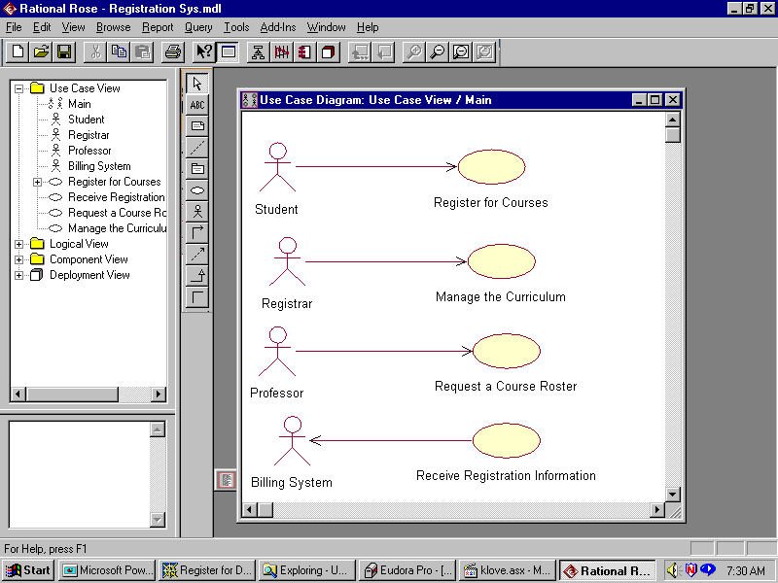

Slide 112
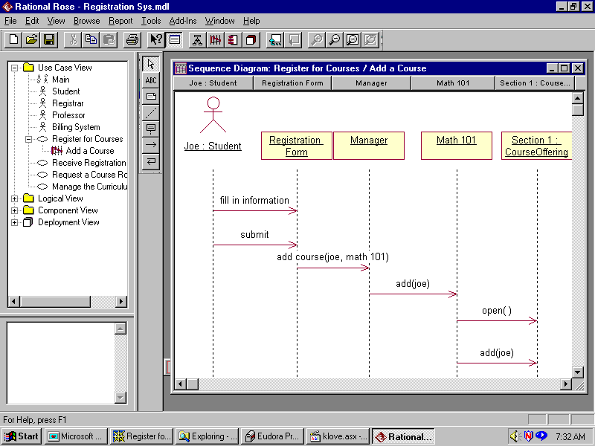

Slide 113
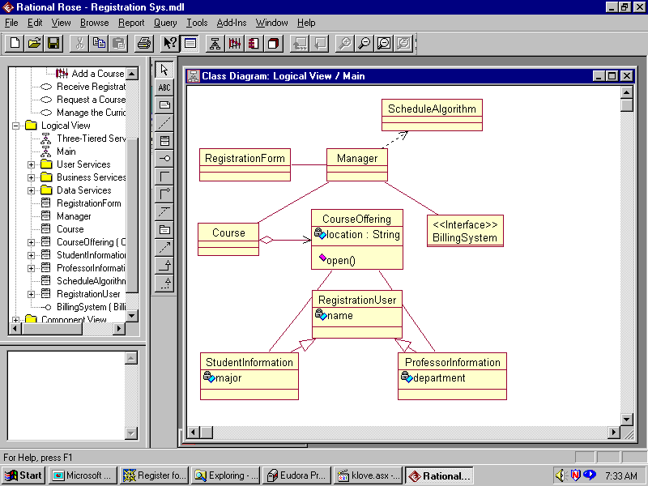

Slide 114
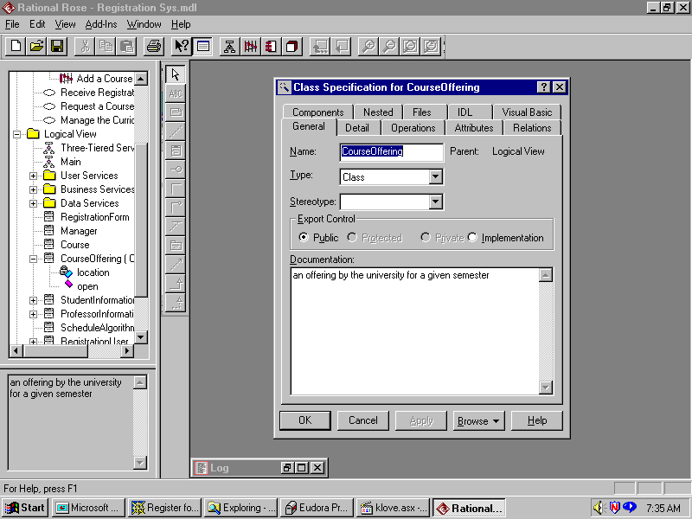

Slide 115
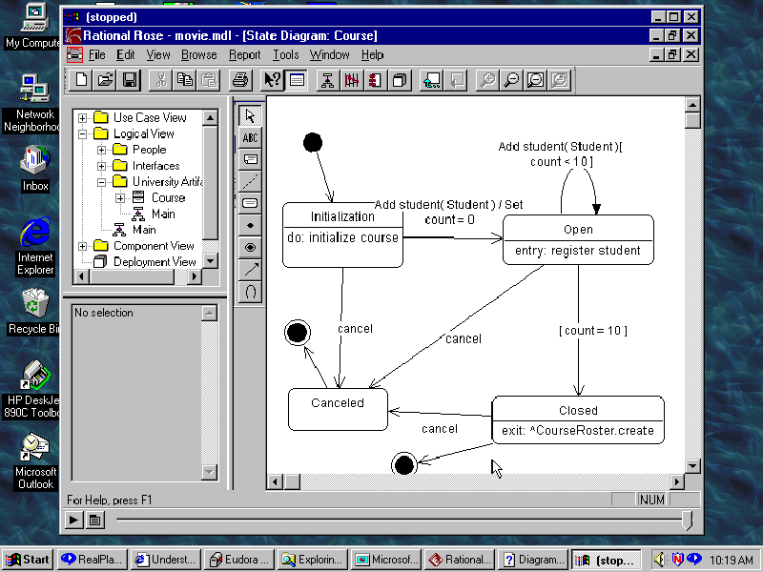

Slide 116
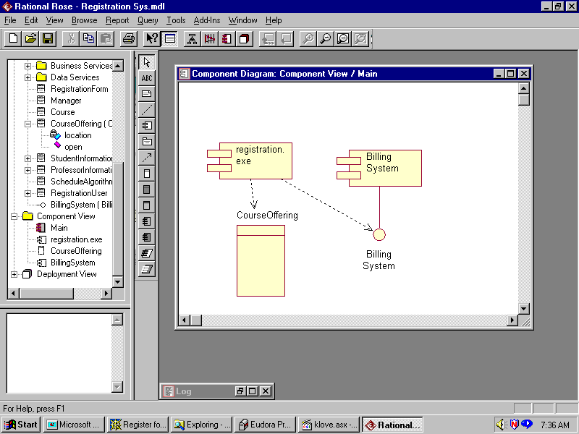

Slide 117
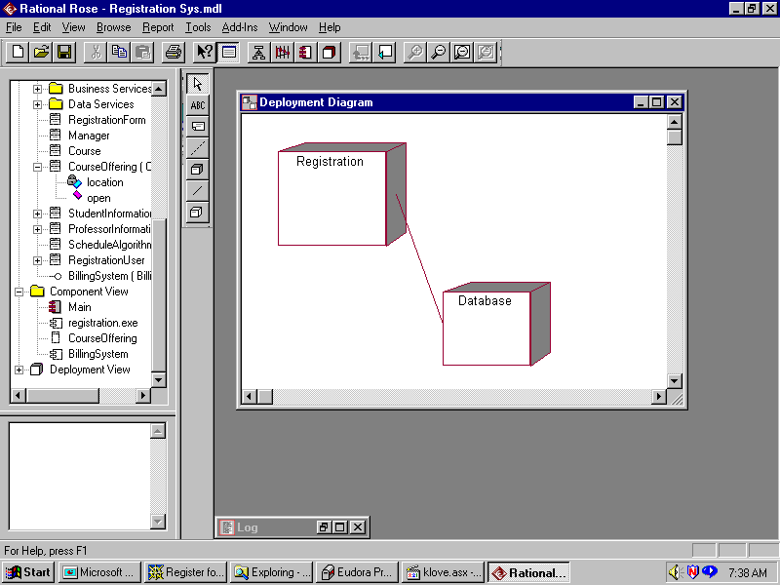

Slide 118
Summary
UML is for visualizing, specifying, constructing, and documenting with emphasis on system architectures (things in the system and relationships among the things) from five different views
UML as a standard language to represent the O-O model is widely accepted.
Notes:
During this lecture, we introduced many concepts. I have not anticipated you can remember all these concepts. We will discuss these concepts in more detail in the following chapters.

Slide 119
Thanks cao-jian@cs.sjtu.edu.cn
Some materials come from Lawrence Chung’s CS6358 PPT, Ronald J. Norman’S IDS306 PPT
and others from Internet

